Slide 1
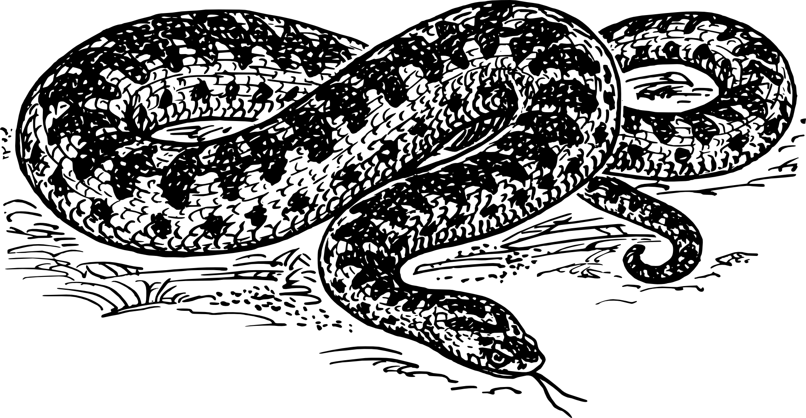
Python Day - Intermediate

Slide 2
